Slide 1


SmartXm
Cross-Platform Desktop Exam Management with Integrated Judge

Slide 2
Project: SmartXm
Course: 0714 02 CSE 3104 Course Name: Software Engineering and Information Systems Project/Fieldwork
Course Teacher: Dr. Kazi Masudul Alam, Professor, Computer Science and Engineering Discipline, Khulna University.
Team members: Ibnul Abrar Shahriar Seam (Student ID: 230201) MD. Siam Ahmed (Student ID: 230202) Kazi Rifat Morshed (Student ID: 230220)

Slide 3
SmartXm at a glance
Cross-platform desktop application
Exam management
Integrated Code Editor
Integrated judge
Automated and Manual Evaluation
Centralized Data Management
Notes:
So, what is SmartXm

Slide 4
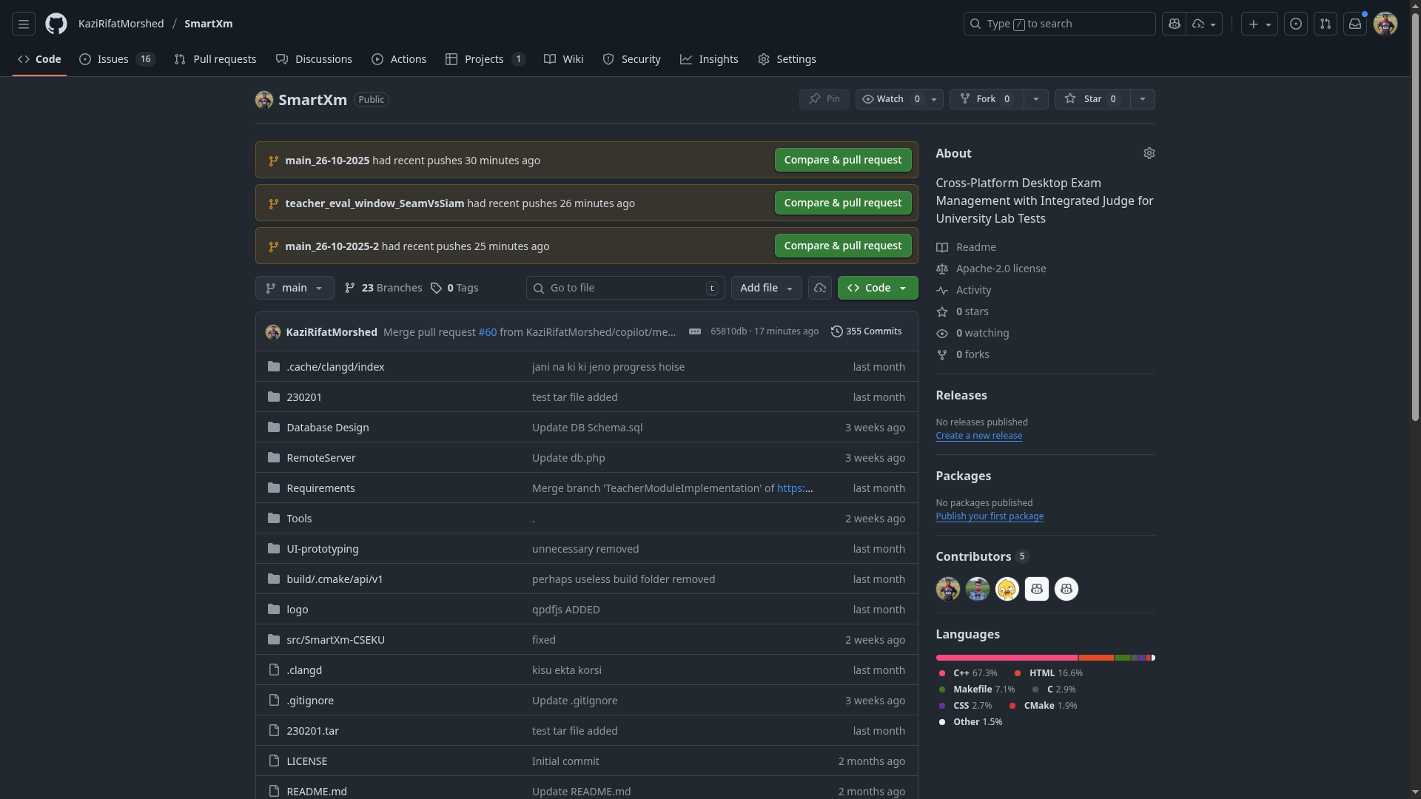
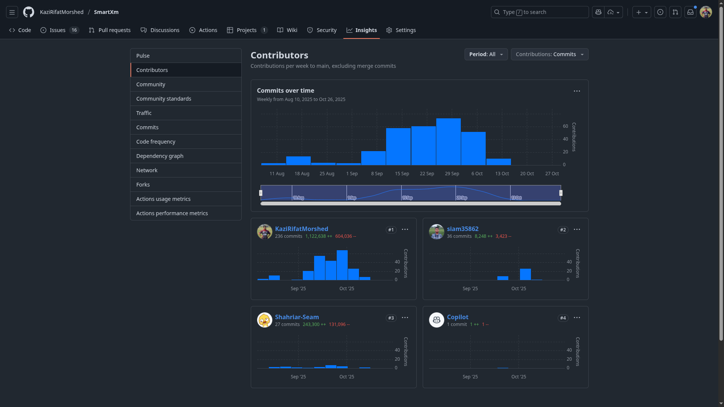
Journey

Slide 5
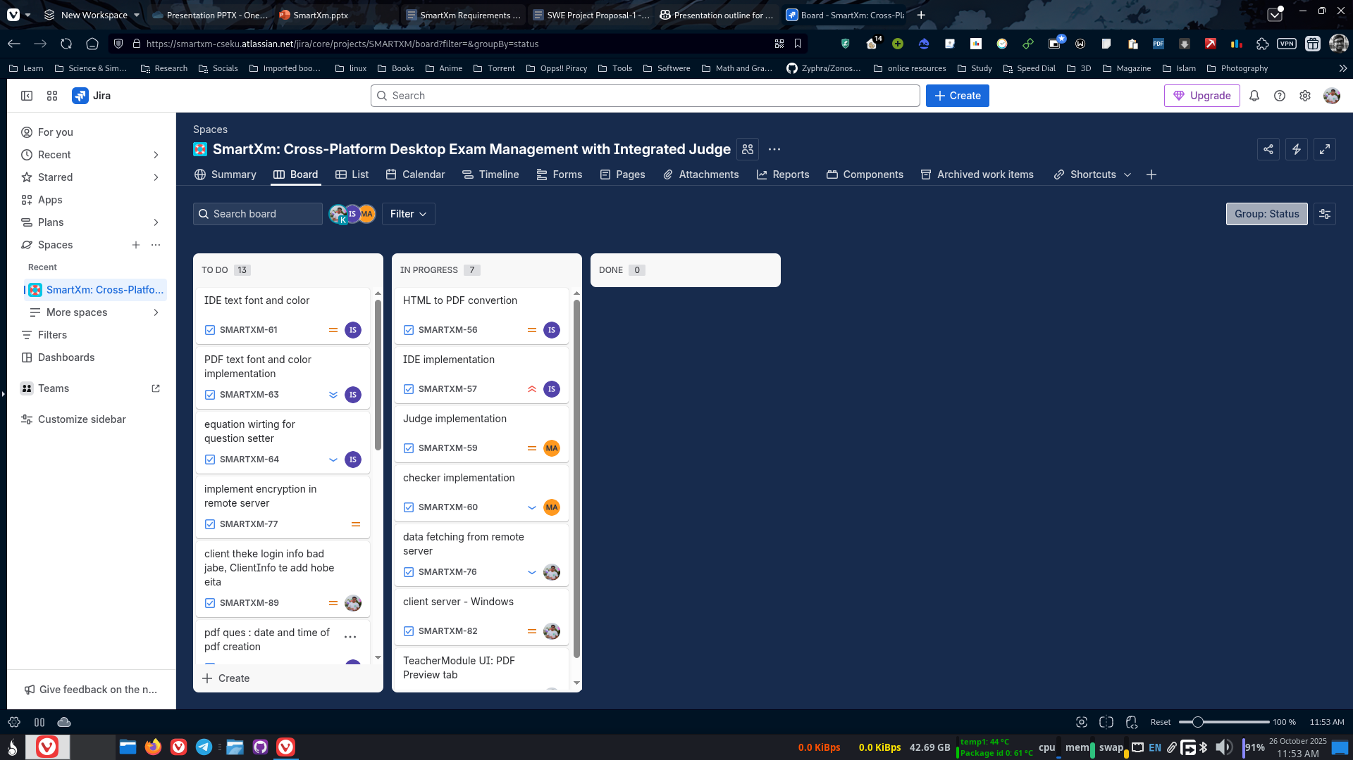
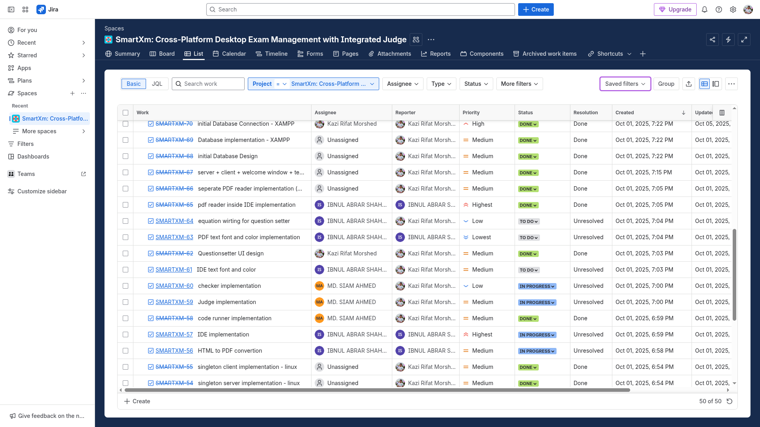
Journey

Slide 6
Motivation
Time-consuming manual grading
Lack of automation
Need of a robust, cross-platform solution

Slide 7
Objectives
Support grading and analytics
Develop cross-platform desktop application
Facilitate exam management system on local network
Integrate an auto-evaluation system (judge) for code-based questions
Allow flexible exam scheduling and control for teachers
Cross-platform desktop application with user-friendly interface for students and instructors

Slide 8

System Overview
A desktop application for managing university lab exams.
Features:
Exam creation and scheduling.
Question management
Automated evaluation for coding questions.
Analytics and secure exam environment.

Slide 9
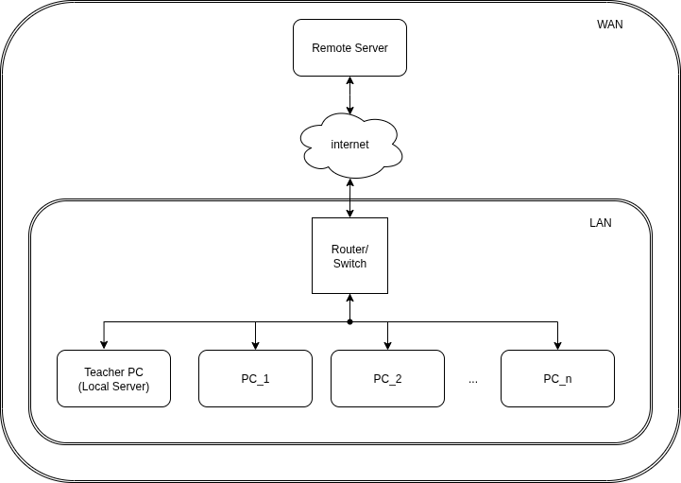
System Overview

Slide 10
Observation: Procedure of the Teacher
Before exam: creates schedule on remote server, selects students, approves study materials
In exam hall: logs in, downloads data to local computer, disconnects WAN
Configures exam: start/end times, extends time, allows late submissions/penalties
After submissions: rejudges codes, checks and marks codes
After marking: students view results (or only system test pass/fail, leaderboard updates)

Slide 11
Observation: Procedure of the Student
Logs into account, code editor opens
Downloads pre-approved code, problem statements, test cases
Problem statement visible at exam start
Codes solution, judges against test cases, leaderboard updates
Solution packaged and sent to local server after exam
Can continue using editor, but no new submissions after time limit

Slide 12
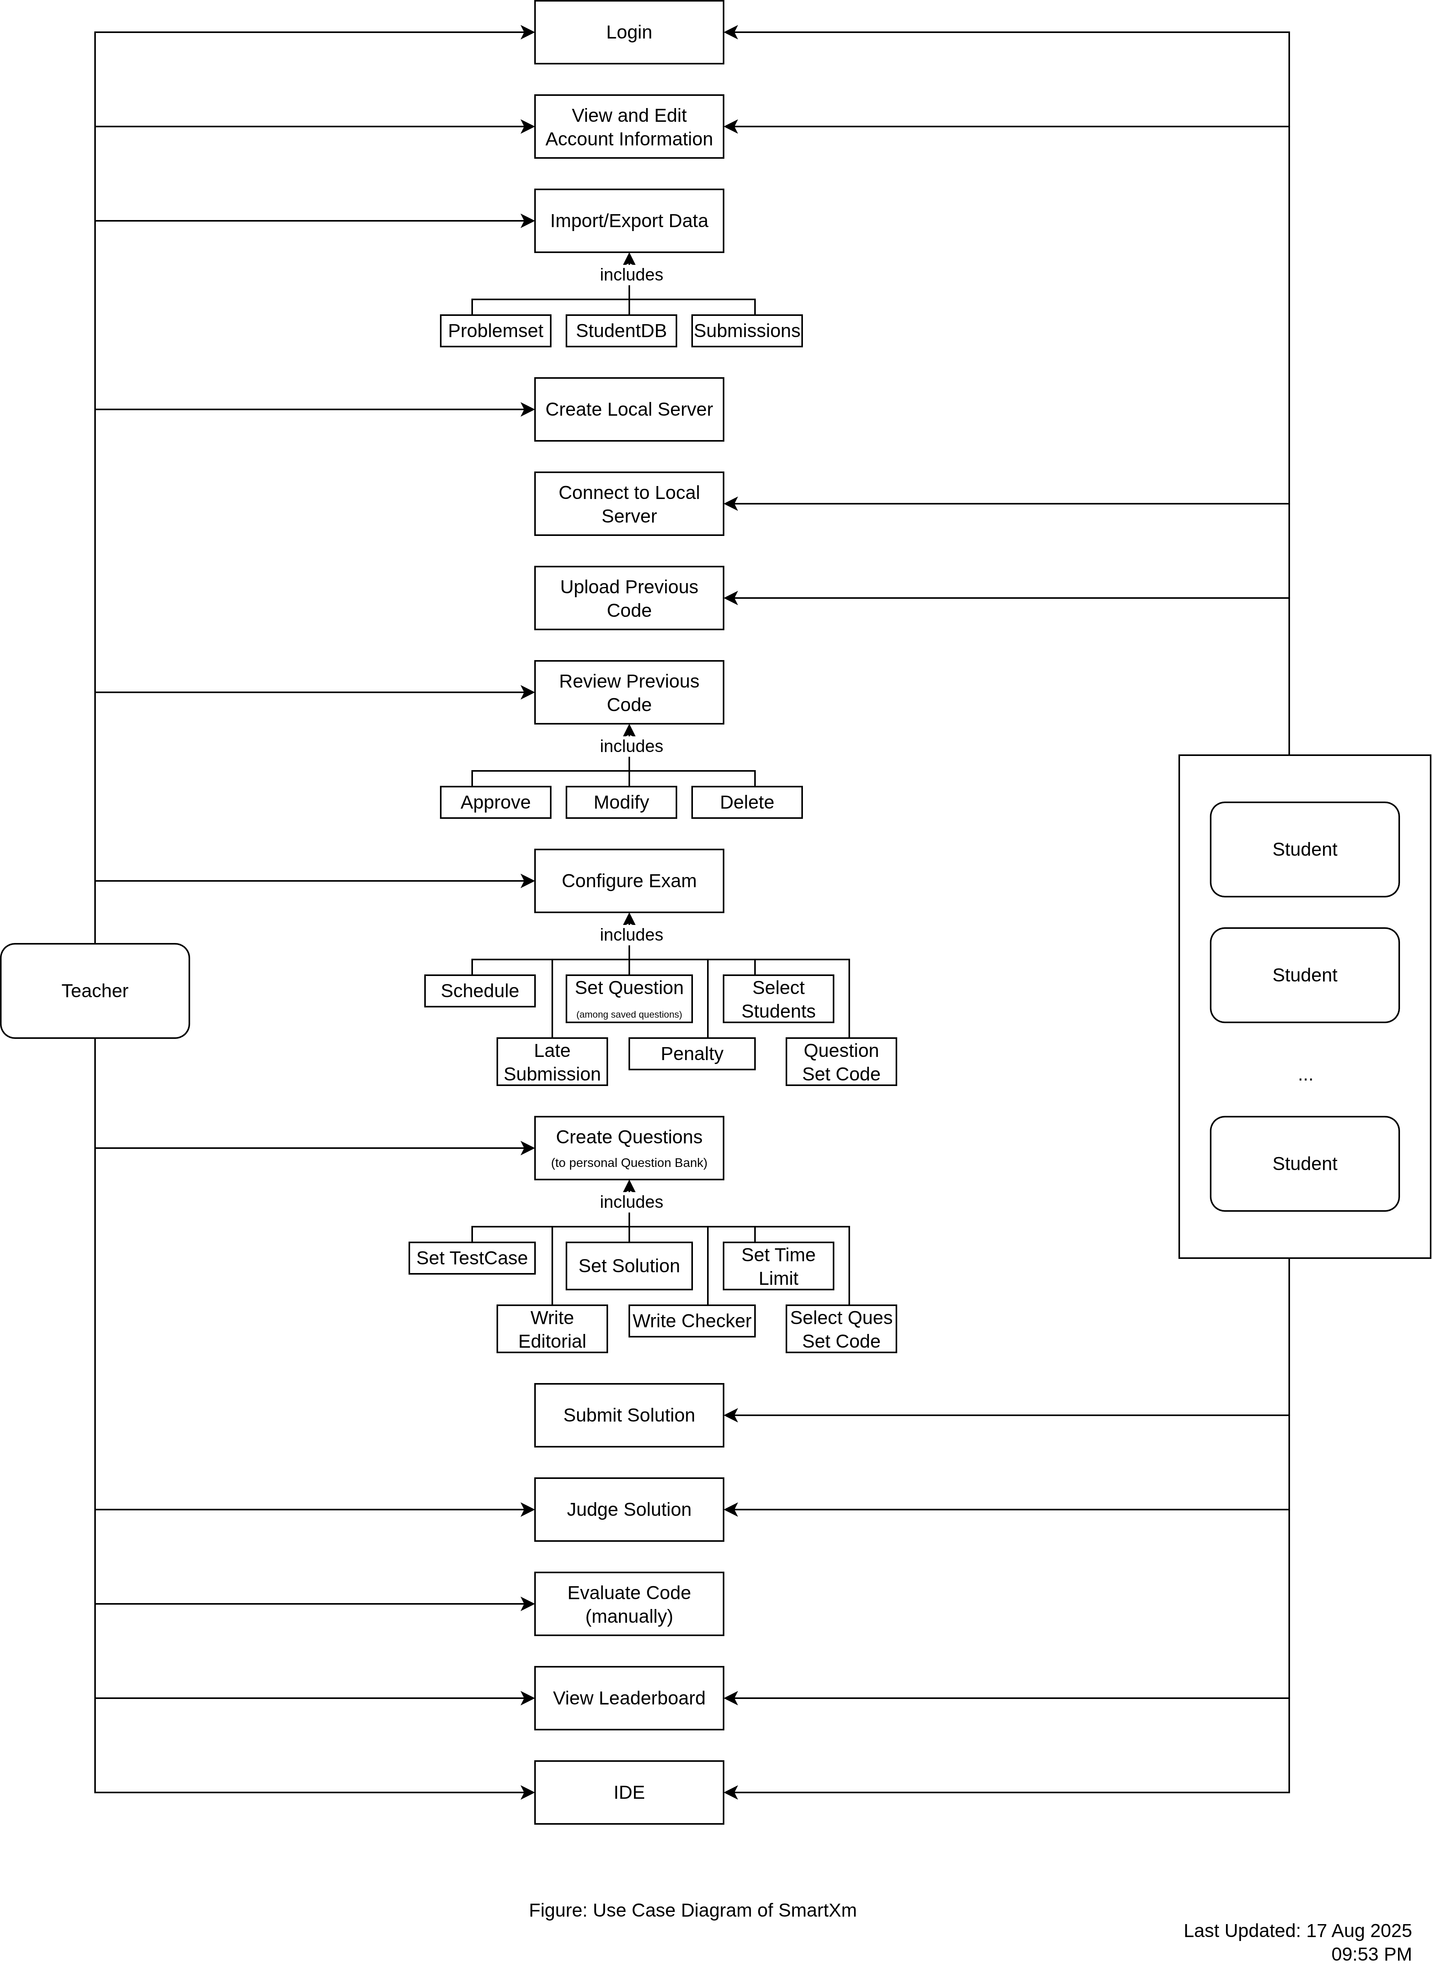
Use case Diagram

Slide 13

Key Features
Teacher dashboard for exam management
Student dashboard for joining exams and submitting solutions
Automatic question distribution and submission collection over a local network
Integrated online judge supporting multiple programming languages
Cross-platform compatibility (Windows and Linux)
Secure data handling and low-latency communication over LAN

Slide 14

Video Demonstration

Slide 15
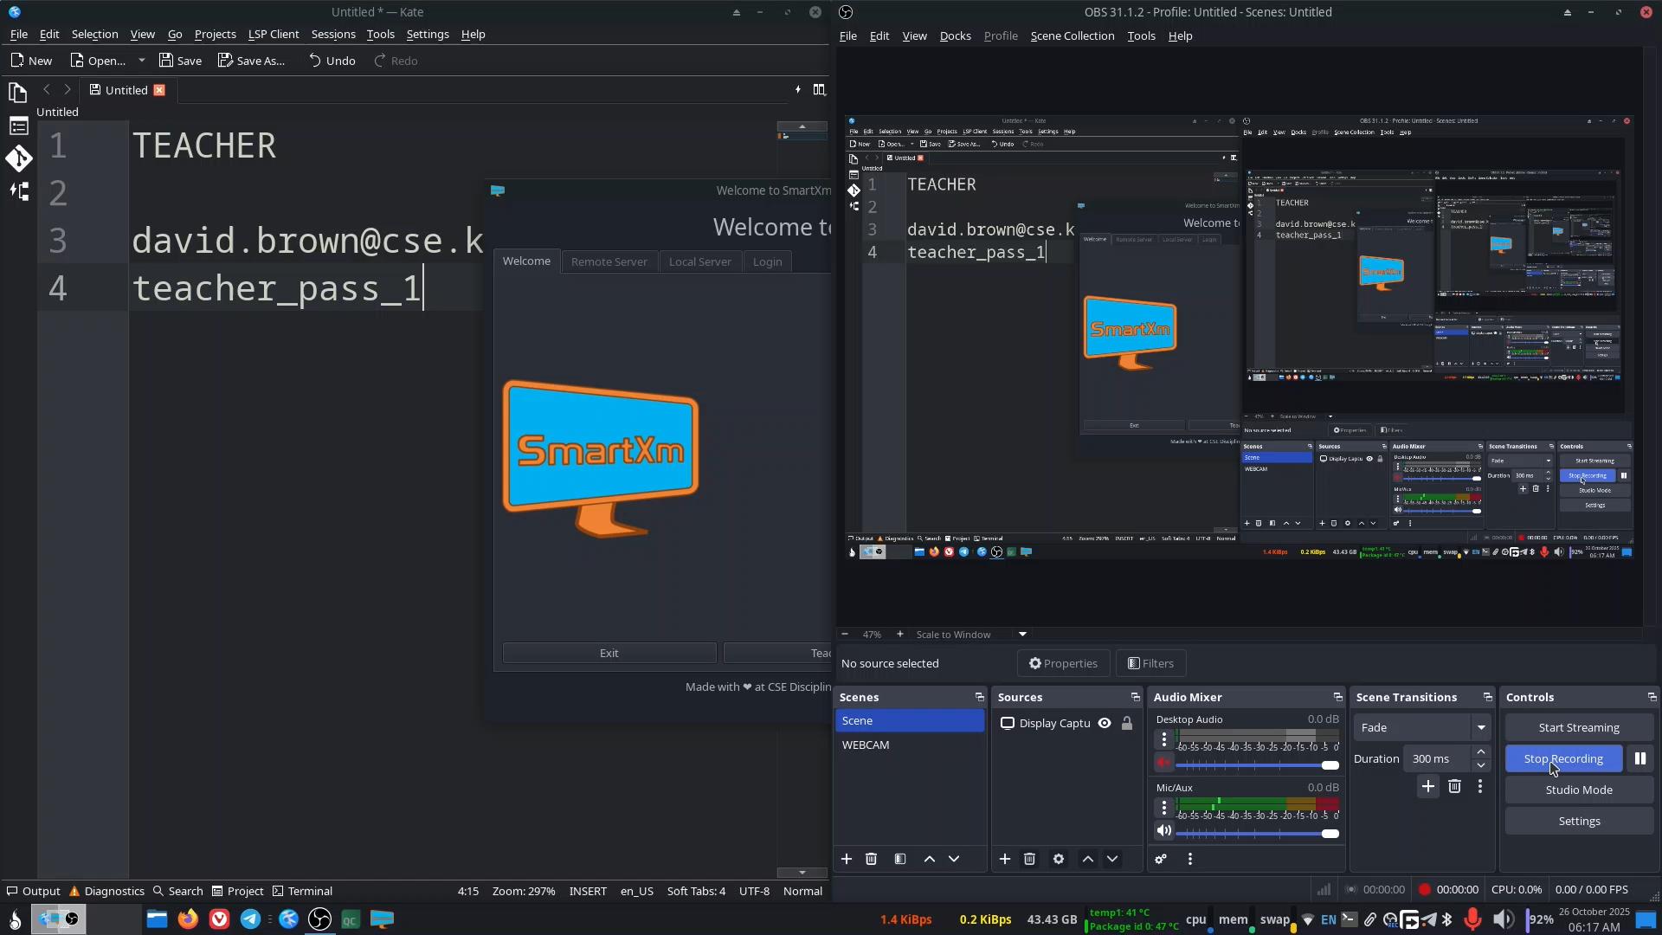

Slide 21

Technologies
Languages and frameworks: C++, Qt, QMake, Ninja, MySQL, SQLite, PHP, python (Selenium)
Compilers: MSVC, Clang, GCC
IDE: QT Creator, Microsoft Visual Studio 2022
Libraries: Windows.h, WinSoc2, qScintilla2, Nicad-4.0 - University of Saskatchewan,

Slide 22

Challenges
Implementation of singleton server, client, database handler
Dynamic UI handling
"wchar" datatype: 16-bit in Linux where 8-bit in Windows
Cross-platform compilation error
External dependencies and Bulky Deployment
Reserved Keywords in windows header libraries

Slide 23
Limitations
Client authentication sometimes fails to get response from server
Relaunch application if clients gets disconnected from server
CLI command "xdg-open" not working in Linux
Preventing server from sleep/hibernation
Desktop Notification Service

Slide 24


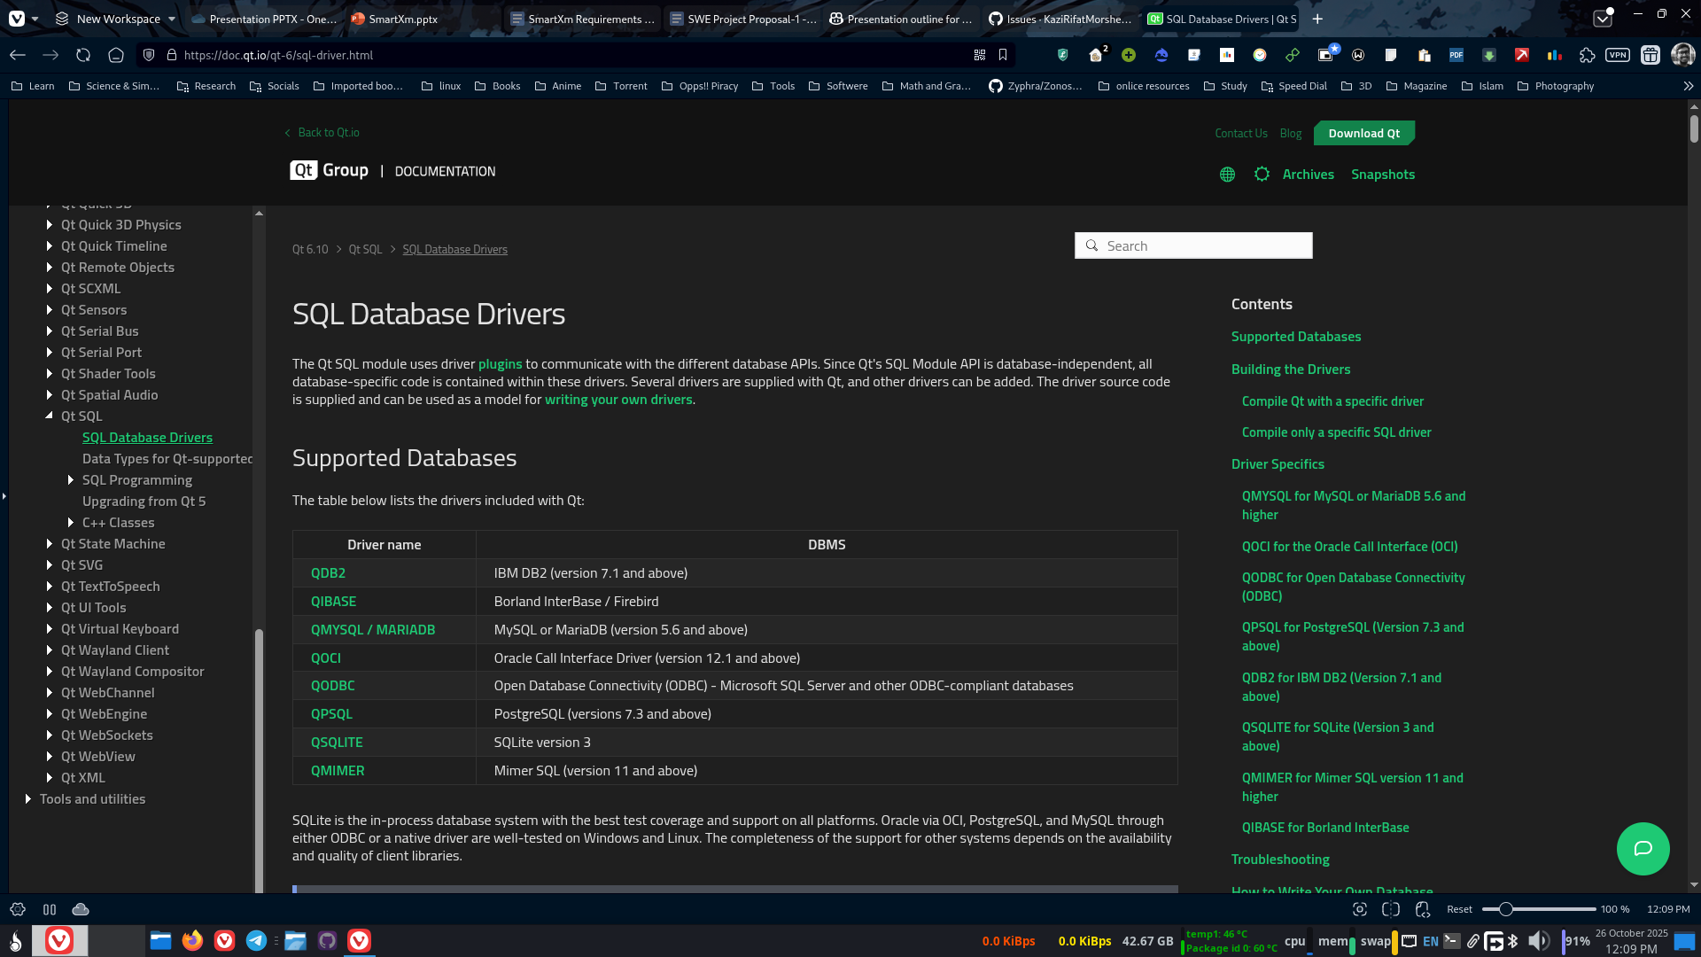

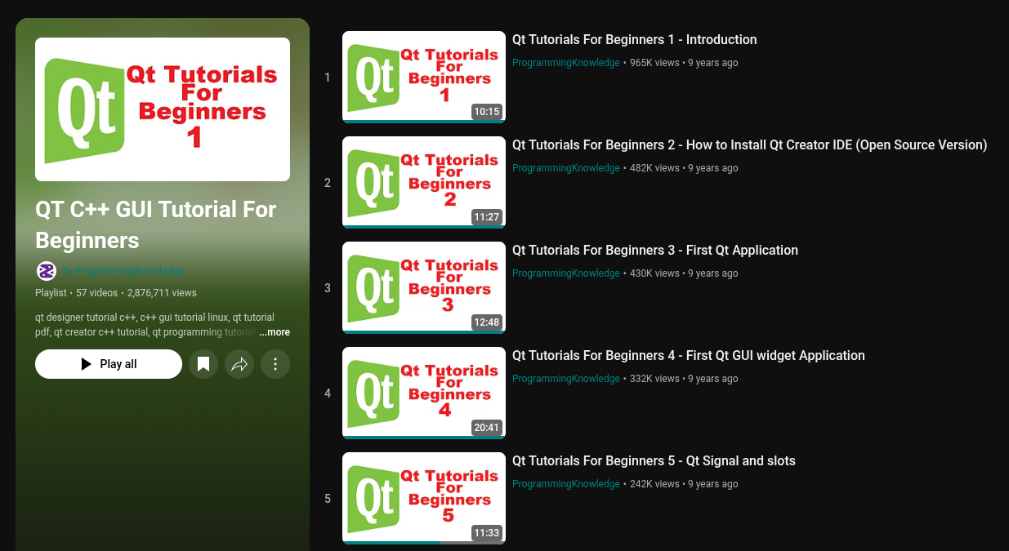
Special Thanks

Slide 25

Thank you very much

